Slide 1
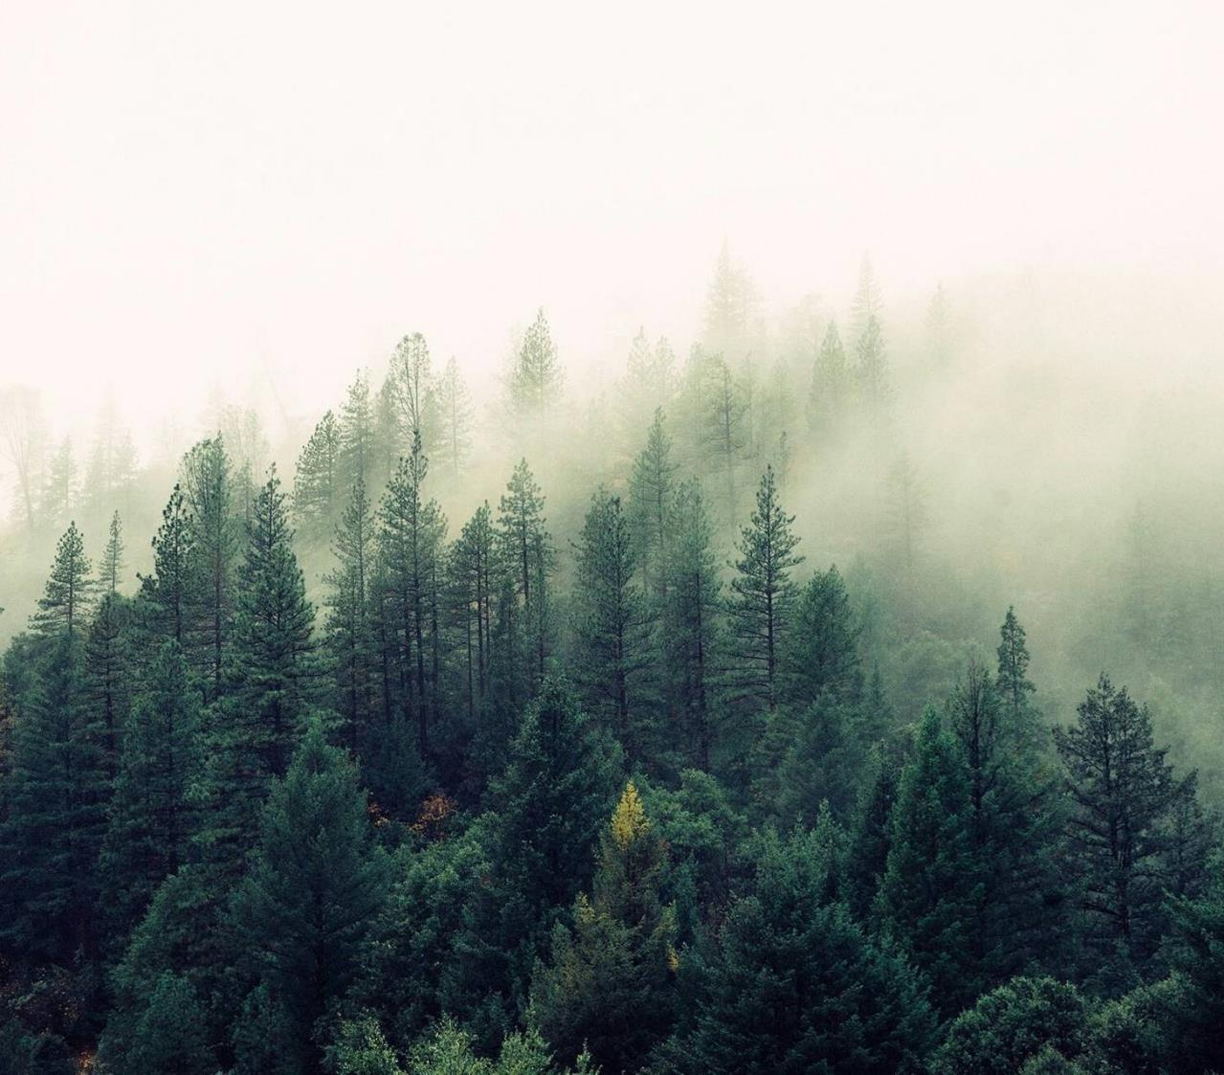
WildeFire Project
Data ScienceTech Institute
Python ML Labs
Quentin VoituroN
Luigi Giannetti
Sascha MOCCOZET

Slide 2
Table of content
Aim of the WildFire Project
Dataset
DataCube
Next Step

Slide 3
Aim of the WildFire Project
Create a Python Artificial Intelligence to output a better result as the FWI (Fire Weather Index) in term of accuracy, prediction and resolution, for cheaper.
The output will be a risk map for a given time (1day) and location (1km²) of wildfire prediction (low risk, medium risk, high risk, …) targeted on the PACA France region.
We will be able to evaluate our model on 2 results:
Against the FWI results (using the FWI results)
Against the real world (using our database on past data)
Notes:
FWI is expensive and only available in some rich country.
Risk to define.

Slide 4
Aim of the WildFire Project
Must Have
Nice to have
Daily risk map
Prediction map for the next day
Create a container to run the script
Notes:
Possibility to tweak the future data in order to see the impact of a given action (density, vegetation …)

Slide 5
Datasets
Leaf Area Index (from MOD15A2H v061)
NDVI (from MOD13A2 v061)
Evapotranspiration (from MOD16A2 v061)
Meteorological data (from ERA5-Land variables)
Land Surface Temperature (from MOD11A1 variables)
Fire Weather Index
Active fire variable
Burned mask variables ( from MYD14A2)
Density
Notes:
Start from academical article to benchmark input
TODO LINK TO ARTICLE
LAI => vegetation cover
NDVI / EVI => % vegetation and type of vegetation
Evapotranspiration => masse of water/humidity that get out of the earth (vegetation and ground)
Meteorological data => rain, temperature, wind
LST =>
FWI => meteorogical data
Active fire => day of first and last fire
Burned mask => where and when are wildfire (not same origin as Active Fire)
Density => Number of people by pixel

Slide 6
Datasets - Leaf Area Index - Description
Extracted : MOD15A2H v061
Start Date : 2009-12-27 00:00:00
End Date : 2022-08-29 00:00:00
Resolution: 500m
Projection: sinusoidal
Temporal granulometry: 8 days
Spatial extent: AOI
Content:
Lai_500m (Leaf Area Index) – continuous
range : 0 to 25.4 / unit: m²/m²
dimensionless unit which characterises the canopy of a given ecosystem
Fpar_500m (Fraction of Photosynthetically Active Radiation) - continuous
range 0 to 2.54 / unit: percentage
fraction of photosynthetically active radiation (PAR) in the 400-700 nm wavelengths that is absorbed by a canopy and it can include over-storey, understory and ground cover elements
6

Slide 7
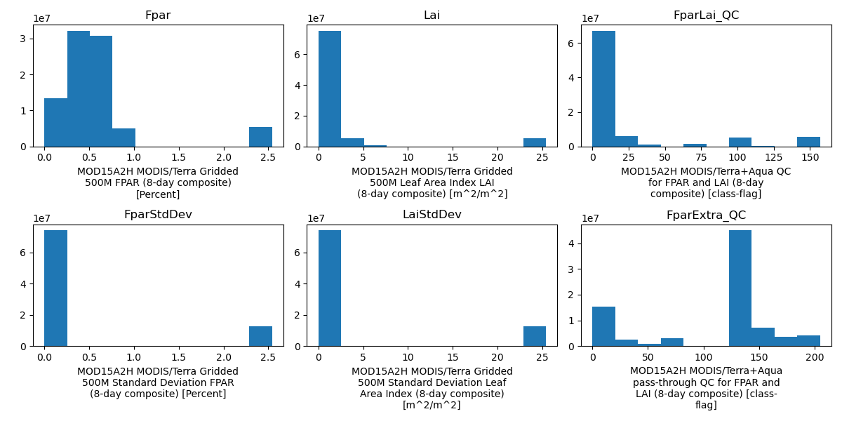
Datasets - Leaf Area Index - Visualization

Slide 8
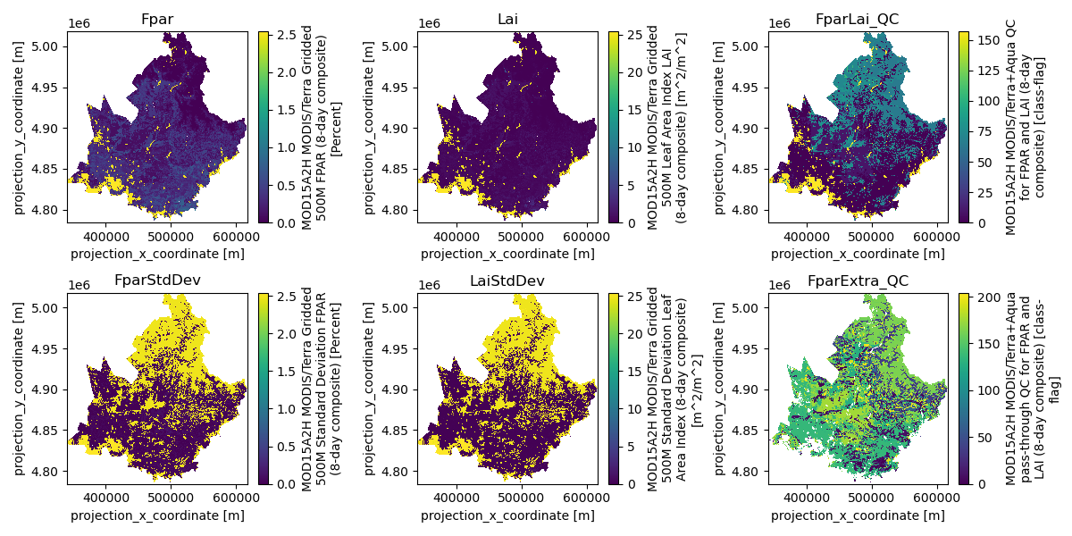
Datasets - Leaf Area Index - Visualization

Slide 9
Datasets - NDVI - Comments
The continuous variables will be useful for the input of the model. Categorical for sub-testing depending on the quality
There is a strong correlation between LAI and FPAR (0.96 over time and spatial dimensions) and we will keep only Fpar has it has a more centered distribution value and closer to 0. It also encompasses somehow the LAI
There is an almost binary distribution of the standard deviation for Fpar an LAI. It might be because of the cities and the mountains
We have categorical variable, so we could not interpolate with a bilinear or cubic resampling, so we will use the nearest neighborhood method. The spatial extent is already crop to the PACA resolution, but we do need updampling the temporal resolution and downsampling the spatial resolution.

Slide 10
Datasets - NDVI - Description
Extracted: MOD13A2 v061
Start Date : 2009-12-19 00:00:00
End Date : 2022-08-13 00:00:00
Resolution: 1000m
Projection: sinusoidal
Temporal granulometry: 16 days
Spatial extent: AOI
Content:
1_km_16_days_EVI (Ehanced Vegetation Index) – continuous
range : -02 to 0,8983 / unit: none
_1_km_16_days_NDVI (Normalized Differentiation Vegetation Index) - continuous
range -02 to 1 / unit: none
_1_km_16_days_VI_Quality - categorical
10

Slide 11
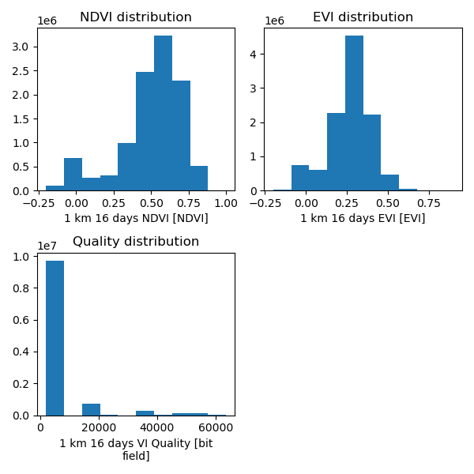
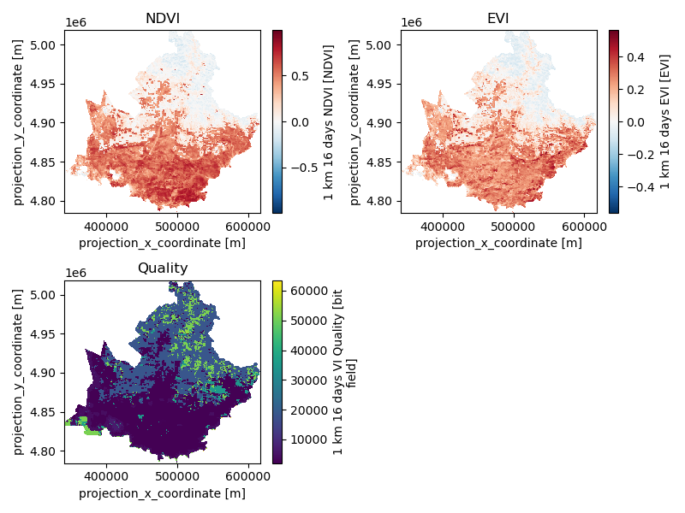
Datasets - NDVI - Visualization

Slide 12
Datasets - NDVI - Comments
EVI and NDVI have the same range of value, but the EVI is centered whereas NDVI has a left skew distribution.
We can see there is a strong correlation between NDVI and EVI (0.88 over time and spatial dimension), which is expected, and we will keep only EVI as it is an upgrade of the NDVI.
There is almost an overlap with the quality of the data and with value around 0 for EVI and NDVI, so we need to have a closer look when preprocessing if we can consider these value.
Because of the categorical value of the quality variable, we can't use bilinear or cubic interpolation, we will use nearest to keep the same categorical value.
The spatial extent is already crop to the PACA extent, but we do need updampling the temporal resolution.

Slide 13
Datasets - Evapotranspiration - Description
Extracted: MOD16A2 v061
Start Date : 2009-12-27 00:00:00
End Date : 2022-08-29 00:00:00
Resolution: 500m
Projection: sinusoidal
Temporal granulometry: 8 days
Spatial extent: AOI
Content:
ET_500m (Total Evapotranspiration) – continuous
range : 0 to 3.277e+03 / unit: kg/m²/8day
LE_500m (Average Latent Heat Flux) - continuous
range 0 to 3.277e+08 / unit: J/m²/day
PET_500m (Total Potential Evapotranspiration) – categorical
range -0,4 to 3.277e+03 / unit: kg/m²/8day
PLE_500m (Average Potential Latent Heat Flux) - continuous
range 0 to 3.277e+08 / unit: J/m²/day
ET_QC_500m (Evapotranspiration Quality Control flags) - categorical
range 0 to TODO / unit: bit
13

Slide 14
Datasets - Evapotranspiration - Comments
ET is the mass of evaporated water per unit area per unit time, and LE is the latent heat flux, which is the energy flux associated with the evaporation of water.
The two variables are strongly correlated, and we will keep only ET.
There is no difference between the portential and actual. So we will keep only the ET_500m.

Slide 15
Datasets - Meteorological data - Description
Extracted: ERA5-Land variables
Start Date : 2010-01-01 04:00:00
End Date : 2022-07-31 20:00:00
Resolution: 9000m
Projection: WG84 --> EPSG 4326
Temporal granulometry: 4 hours
Content:
U10 (Eastward component of the 10m wind) – continuous
range : -17,09 to 15,15 / unit: m/s
V10 (Northward component of the 10m wind) - continuous
range -15,89 to 14,17 / unit: m/s
T2m (Temperature of air at 2m above the surface of land, sea or in-land waters. The temperature measured in kelvin can be converted to degrees Celsius (°C) by subtracting 273.15) – continuous
range 244 to 317 / unit: K
Tp (precipitation) - continuous
range 0 to 0,122 / unit: m
15

Slide 16
Datasets - Meteorological data - Comments
Nothing to do with the data.
We need to project the dataset into a sinusoidal projection and clipping to the right AOI.
We will also need to regridding to a 1km resolution and downsampling to a daily temporal resolution.
We must be careful and checking the dataset again after all this transformation.

Slide 17
Datasets - Land Surface Temperature - Description
Extracted: MOD11A1 variables
Start Date : 2009-12-28 00:00:00
End Date : 2022-09-01 00:00:00
Resolution: 1000m
Projection: sinusoidal
Temporal granulometry: 1 days
Spatial extent: AOI
Content:
LST_Day_1km (Land Surface Temperature day) – continuous
range : 240,0 to 332,9 / unit: k
LST_Night_1km (Land Surface Temperature day) - continuous
range 227,3 to 321,2 / unit: k
17

Slide 18
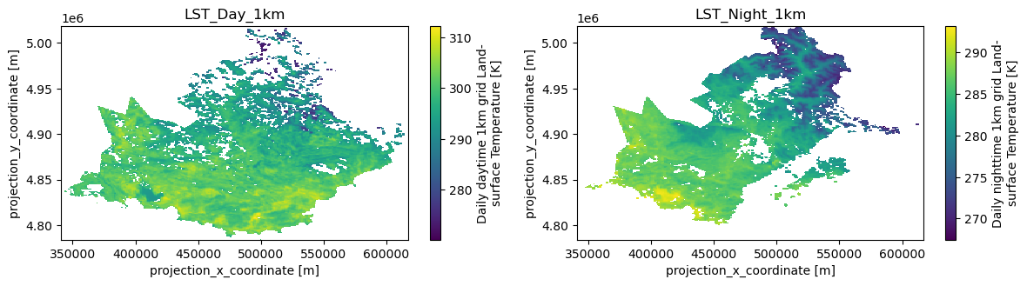
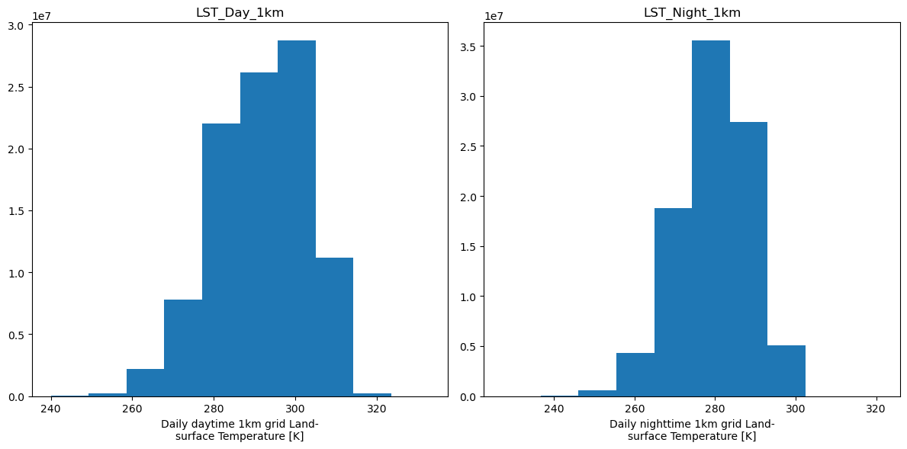
Datasets - Land Surface Temperature - Visualization

Slide 19
Datasets - Land Surface Temperature - Comments
Nothing to do with the data

Slide 20
Datasets - Fire Weather Index - Description
Extracted: MOD11A1 variables
Start Date : 2010-01-01 00:00:00
End Date : 2022-12-31 00:00:00
Resolution: 0,25°
Projection: rotated pole
Temporal granulometry: 1 days
Spatial extent: Europe
Content:
FWI (Fire Weather Index) – continuous
range : 1to 473 / unit: none
20

Slide 21
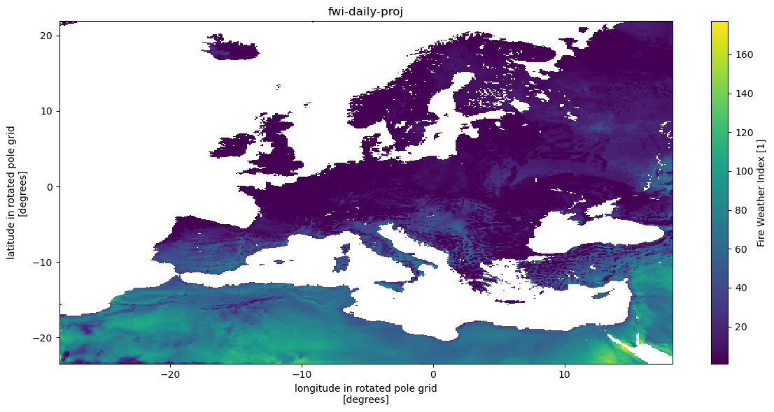
Datasets - Fire Weather Index - Visualization

Slide 22
Datasets - Fire Weather Index - Comments
The fire weather index can be categorized into 6 classes of danger as follows:
Need to change the extent and the projection
Very low danger
Low danger
Moderate danger
High danger
Very high danger
Extreme danger
5,2
11,2
21,3
38
50

Slide 23
Datasets - Active fire variable - Description
Extracted: MCD64A1 v061
Start Date : 2010-01-01 00:00:00
End Date : 2022-02-01 00:00:00
Resolution: 500m
Projection: sinusoidal
Temporal granulometry: 1 month
Spatial extent: AOI
Content:
Burn_Date (ordinal day of burn) – categorical
range : 0 to 366 / unit: day
First_Day (First day of the year of reliable change detection) – categorical
range : 0 to 366 / unit: day
Last_Day (Last day of the year of reliable change detection) – categorical
range : 0 to 366 / unit: day
Burn_Date_Uncertainty (Estimated uncertainty in burn day) – categorical
range : 0 to 100 / unit: day
QA (Quality Assurance Indicators) – categorical
range : 0 to TODO / unit: bit
23

Slide 24
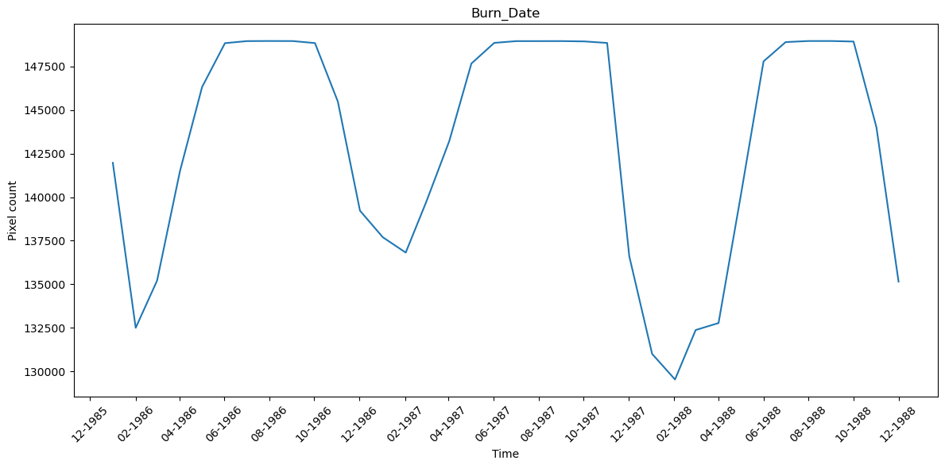
Datasets - Active fire variable – Comment – Burn_Date
There is an issue with the formatting and a shift of 30 years exactly.
We observe the count of active fire seems to follow a pattern with more fire in estival period.
Surprise to observe there are still so many fire all along the year.

Slide 25
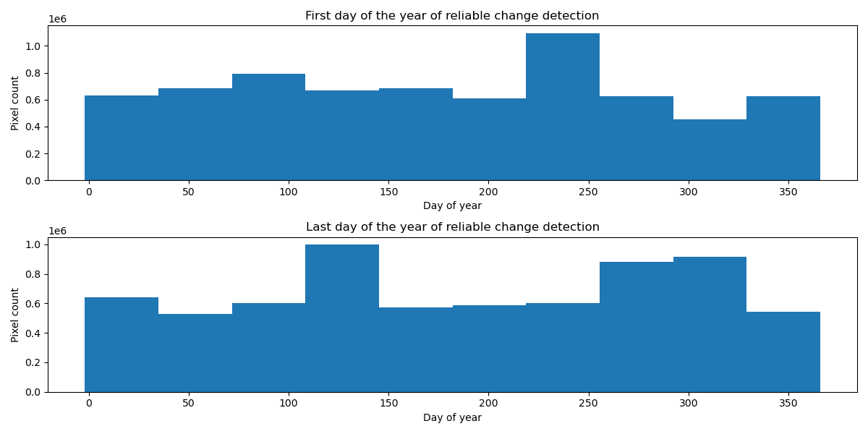
Datasets - Active fire variable – Comments - Burn_Date_Uncertainty
We can interpret that most of the fire extinguished between day 100 and day 150 (Mars-April) and day day 250 to 325(October) and this is significant as it is the most rainy day.
We see also there is a peak for the first day around August.

Slide 26
Datasets - Active fire variable – Comments
Need to merge. Indeed the time resolution is monthly, and the variables are days.
Warning: Have a try on resample to a daily resolution.

Slide 27
Datasets - Burned mask variables - Description
Extracted: MYD14A2 V061
Start Date : 2009-12-27 00:00:00
End Date : 2022-08-29 00:00:00
Resolution: 1000m
Projection: sinusoidal
Temporal granulometry: 8 days
Spatial extent: AOI
Content:
FireMask(ordinal day of burn) – categorical
range : 0 to 9
QA (Quality Assurance Indicators) – categorical
range : 0 to 31
27

Slide 28
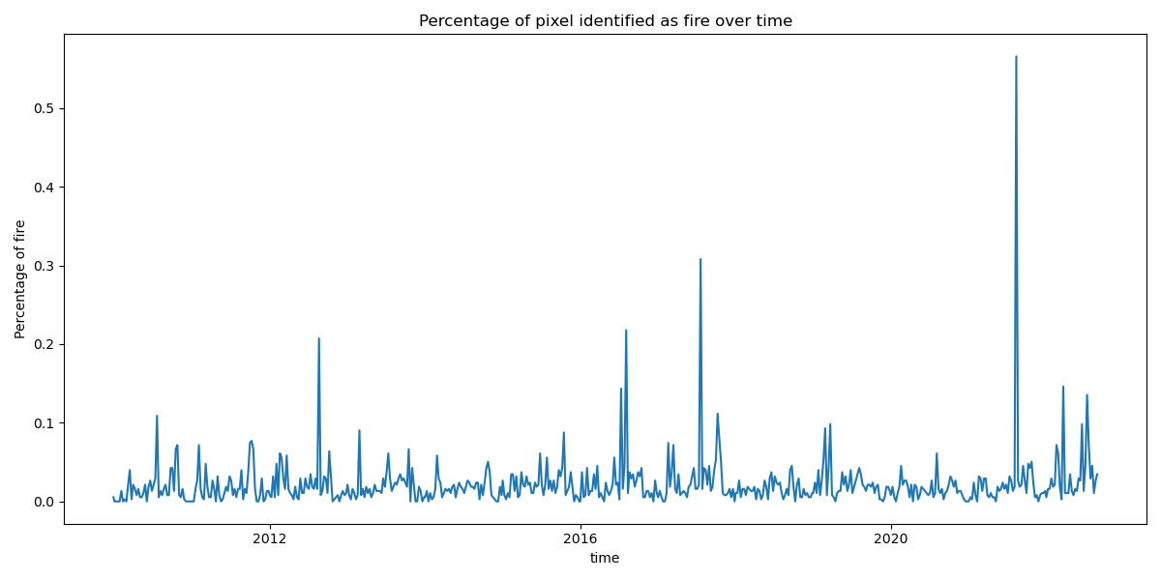
Datasets - Burned mask variables - Visualization

Slide 29
Datasets - Burned mask variables - Comments
We see from the picture most of the time there is no fire, so the final dataset may be very unbalanced

Slide 30
Datasets - Density - Description
Extracted: WorldPop
Date : 2015
Resolution: 1000m
Projection: WG84 EPSG 4326
Temporal granulometry: None
Spatial extent: France
Content:
MAXIMUM: 53646.03515625
MEAN: 119.46772920052
MINIMUM: 0
STDDEV: 644.66432858711
30

Slide 31
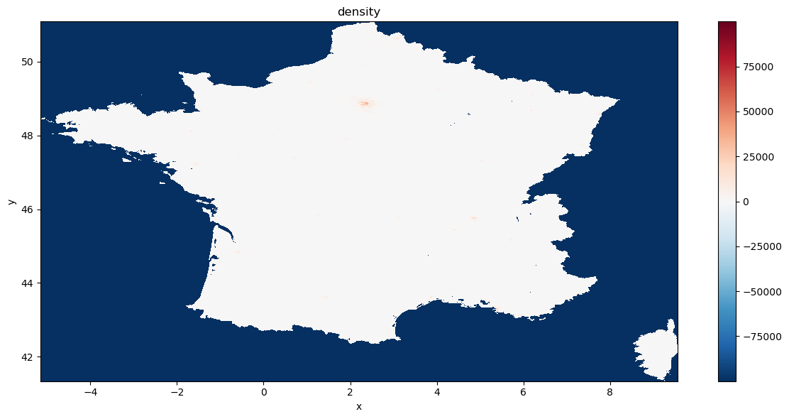
Datasets - Burned mask variables - Visualization

Slide 32
Datasets - Burned mask variables - Comments
Need to be clipped into the AOI and project anti-sinusoidal.
It might be interested to have data based on the population at every moment, holidays.

Slide 33
Datacube
Properties
Variables

Slide 34
Datacube - properties
Time Range : 2010-01-02 to 2022-02-01
Time Resolution: 1 day
Spatial resolution: 1 km
Projection: sinusoidal
Spatial extent: AOI.
Notes:
Why sinusoidal? Because of the area of the fire in ²

Slide 35
DataCube - Variables
Fpar_500m - continuous
FparStdDev_500m - continuous
_1_km_16_days_EVI - continuous
ET_500m - continuous
U10 - continuous
V10 - continuous
T2m - continuous
tp - continuous
LST_Day_1km - continuous
LST_Night_1km - continuous
FWI - continuous
First_Day - categorical
Last_Day - categorical
Burn_Date_Uncertainty - categorical
FireMask - categorical
Density - continuous

Slide 36
Next Step
Pre-Processing
Clean the data
Split the data (Learning / testing)
ML – Model
Define the model to use
Test the model
DevOps
Data versioning
Notes:
Data
Get data on future event
Streaming
DevOps
Docker
Prefect + Airflow
Pre-Processing
Active fire and Burned mask need to be compared and pre-process
ML – Model
Random forest

Slide 37
Difficulty
Dependencies
Projection
Merging of data
Learn: Raster, shapefile, spatiotemporal data,...
Unbalanced Dataset

Slide 38
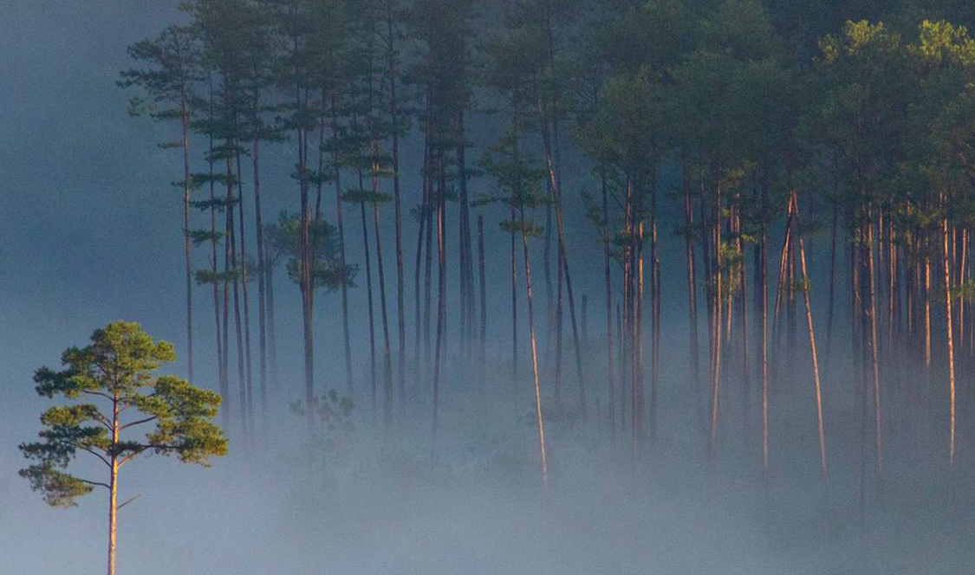
Thank you

